Slide 1
Hands-on Generative AI Engineering with Large Language Models
Quang Duong

Slide 2







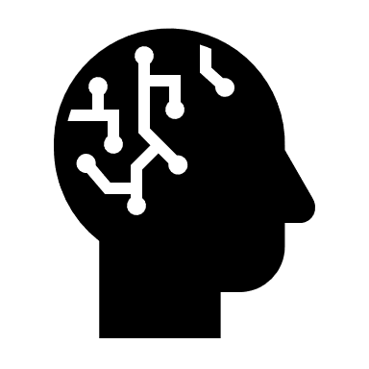

Big Picture
User's instructions
Generative AI models
New contents
…
…
Trained on vast data
AI apps
Generative AI
New text contents
User's instructions
as text
Large Language Models
DL
ML
Hands-on Engineering
AI
…

Slide 3
Introduction to the Course
Course objectives
Course structure
Learning paths

Slide 4
Course Objectives
Hands-on engineering for Generative AI with Large Language Models
Understanding how to build, implement, train, and infer a Large Language Model, such as a Transformer
Understanding the different components needed to build an LLM-based app
Leveraging various tools and frameworks to build LLM-based apps
Learning how to serve and deploy your LLM-based app
Guidance on advanced engineering topics in Generative AI with Large Language Models

Slide 5
Course Structure
Beyond the Course
7.
6.
7 Parts +
5.
Hands-on Generative AI Engineering with Large Language Models
4.
3.
2.
1.
Introduction to the Course
We are here

Slide 6



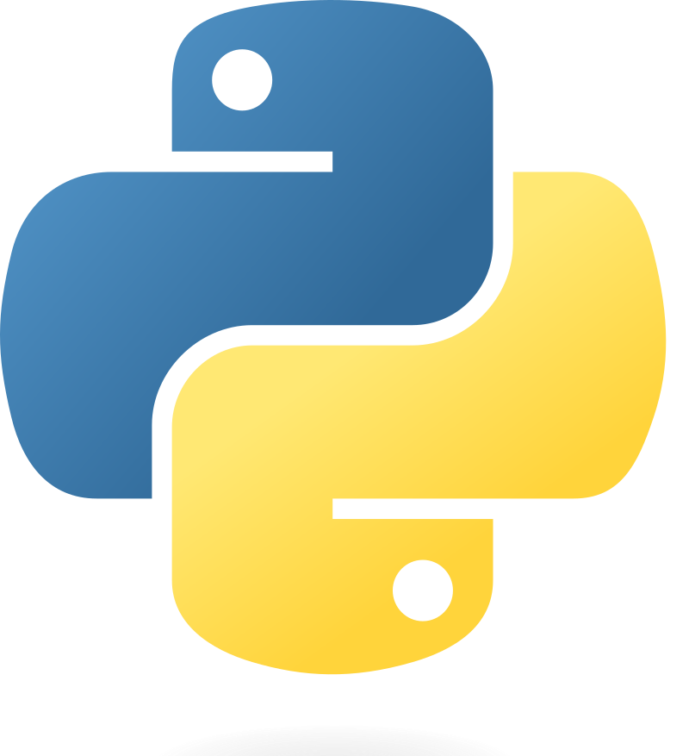



Course Structure
1.
Software Prerequisites for Python Projects

Slide 7
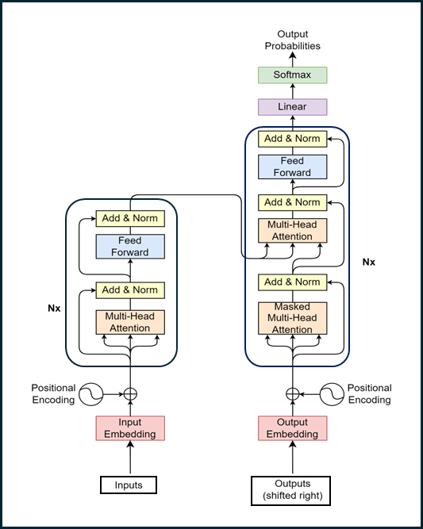
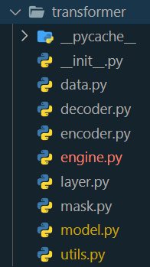
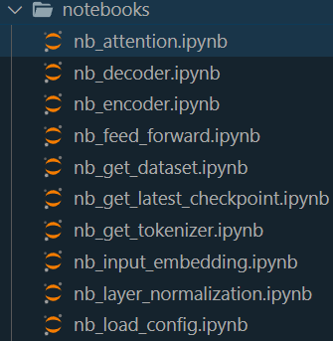

Course Structure
3.
Implementing Transformer in Python and PyTorch
2.
Introduction to Transformer – Attention Is All You Need

Slide 8
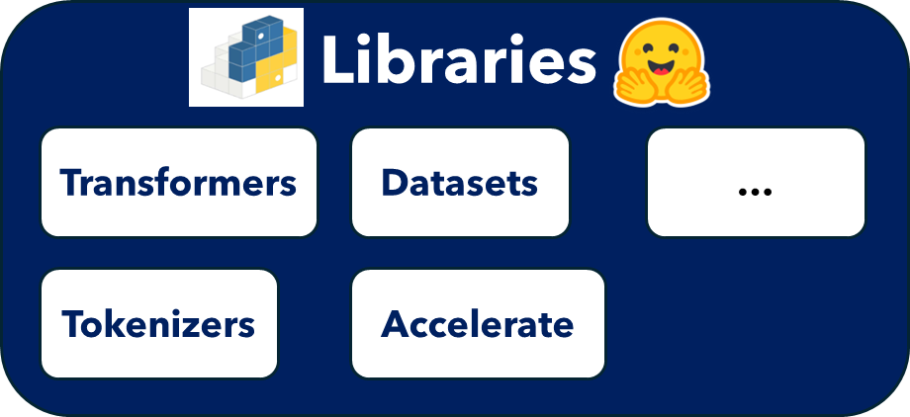
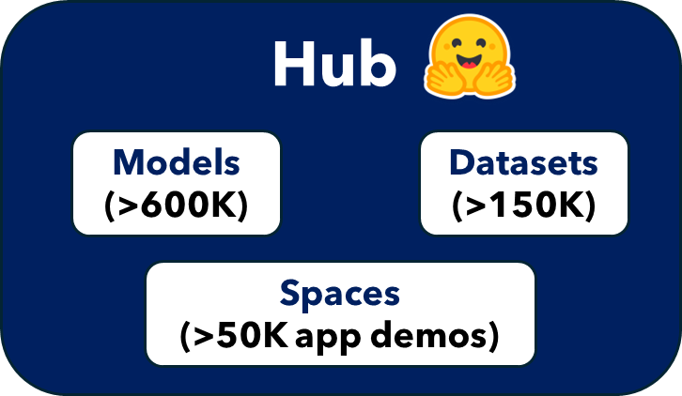

Course Structure
4.
Generative AI with the Hugging Face Ecosystem

Slide 9
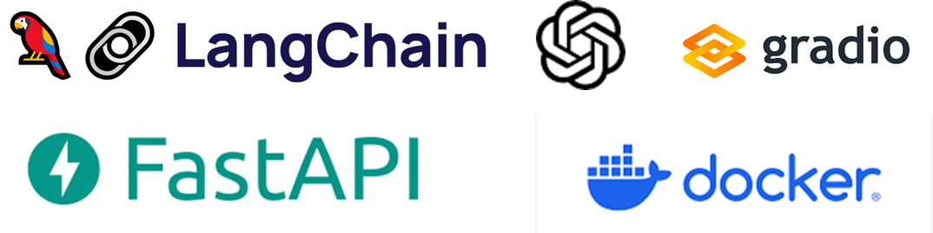
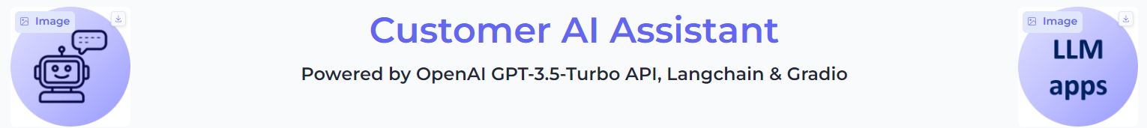
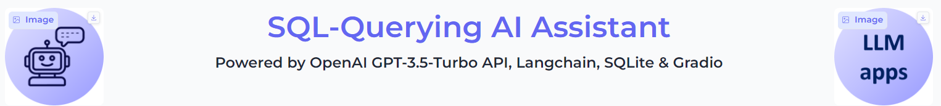
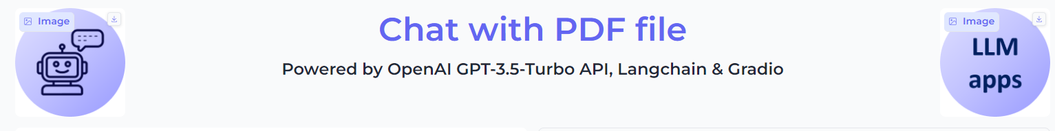
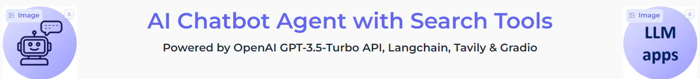

Course Structure
7.
Serving LLM-based Web Applications
6.
Building LLM-based Web Applications
5.
Components to Build LLM-based Web Applications
…

Slide 10
Course Structure
Beyond the Course
Guidance on advanced concepts, up-to-date advancements in LLM vs Generative AI, …

Slide 11
Course Structure
Beyond the Course
Guidance on advanced concepts, up-to-date advancements in LLM vs Generative AI, …
7.
Serving LLM-based Web Applications
6.
Building LLM-based Web Applications
7 Parts +
5.
Components to Build LLM-based Web Applications
Hands-on Generative AI Engineering with Large Language Models
4.
Generative AI with the Hugging Face Ecosystem
3.
Implementing Transformer in Python and PyTorch
2.
Introduction to Transformer – Attention Is All You Need
1.
Software Prerequisites for Python Projects
Introduction to the Course
We are here

Slide 12
Learning Paths
Beyond the Course
Guidance on advanced concepts, up-to-date advancements in LLM vs Generative AI, …
7.
Serving LLM-based Web Applications
6.
Building LLM-based Web Applications
5.
Components to Build LLM-based Web Applications
4.
Generative AI with the Hugging Face Ecosystem
3.
Implementing Transformer in Python and PyTorch
2.
Introduction to Transformer – Attention Is All You Need
1.
Software Prerequisites for Python Projects
Introduction to the Course

